Slide 1
Daily Review
Balancing Formula Equations
List the number of each type of element on both sides of the equation.
Choose an element that has unequal numbers
Add coefficients to make them equal and adjust the numbers of elements in the list.
Choose another element that has unequal numbers, add coefficients and adjust the list.
Repeat until all elements have equal numbers.
HNO₃ + Na → H₂ + NaNO₃
Balance the equation using the method shown in class.
2
2
2

Slide 2
Daily Review
Comparing the Properties of Acids and Bases
Acids contain hydrogen in their chemical structure. They taste sour, cause a prickling or burning sensation and are corrosive.
Bases contain hydroxide or carbonate in their chemical structure. They taste bitter and feel soapy. They are corrosive.
Draw and fill out the Venn diagram on your whiteboard to show the properties of acids and bases.
Acids
Bases
Sour
Bitter
Prickling or burning sensation
Corrosive
Feel soapy
Contain either hydroxide or carbonate
Contain hydrogen

Slide 3
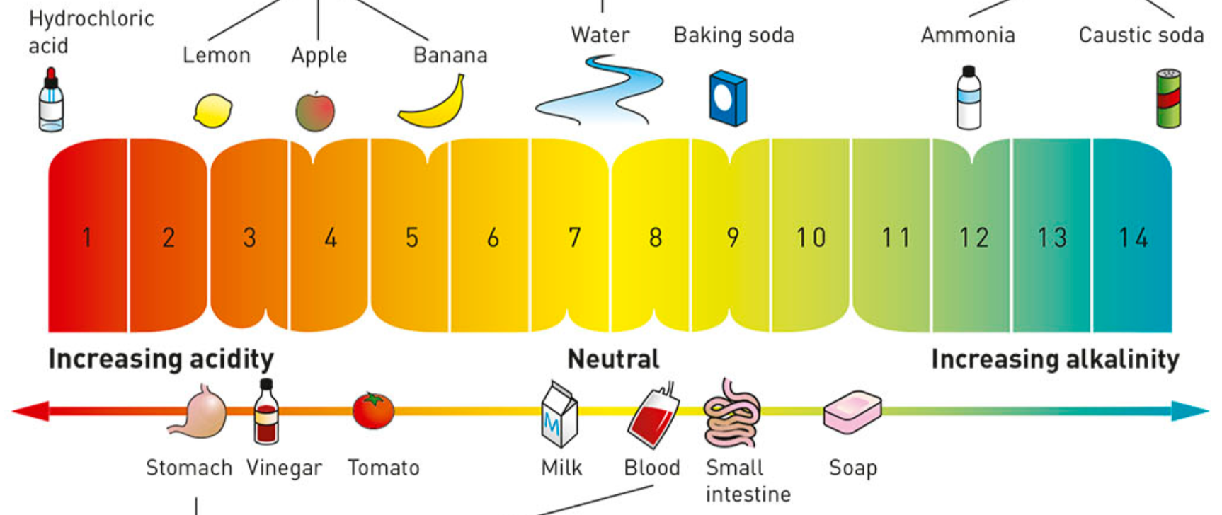
Daily Review
CFU 3
In the diagram, what is the strongest base?
CFU 2
What pH range indicates a base?
CFU 1
What pH range indicates an acid?
pH Scale and Indicators
Indicators and the pH scale is used to show whether substances are acids or bases.
The pH scale ranges from 1 to 14, with 7 being neutral.

Slide 4

Daily Review
Universal Indicator
Universal indicator is a mixture of indicators that shows the pH of substances.
Hydrochloric acid is a strong acid. What colour would universal indicator show?
Baking soda is a weak base. What colour would universal indicator show?

Slide 5
Reaction of Acids With Metals Year 9 Science

Slide 6
Learning Objectives
CFU
What are we learning about?
Predict products of reactions between acids and metals
Define and identify salts
Activate Prior Knowledge
Some compounds are made from a metal and a non-metal. Sodium chloride (table salt) contains one atom of sodium and one of chlorine. Its chemical formula is NaCl.
For each of the compounds listed below, underline the metal atom and put a circle around the non-metal.
ZnO MgCl₂ FeO AlBr₃

Slide 7
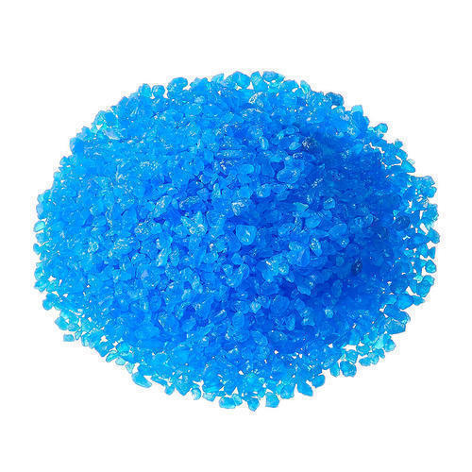
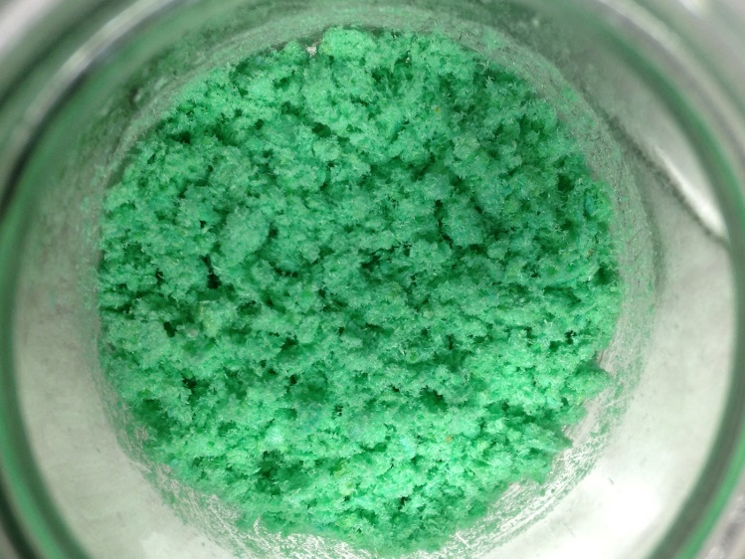
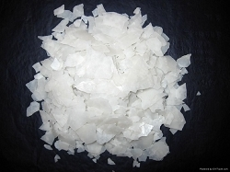
Concept Development
CFU 1
How are salts defined by scientists?
Salts
In our everyday language, the word salt refers to the stuff we put on our food to make it taste better.
To a scientist, the term salt refers to any compound made from a metal and a non-metal (or group of non-metals).
Magnesium chloride (MgCl₂), copper chloride (CuCl₂), and copper sulfate (CuSO₄) are all salts.
CFU 2
Which of the compound listed below are salts? Explain your choice. Sodium bromide, NaBr Aluminium chloride, AlCl₃ Glucose, C₆H₁₂O₆ Calcium carbonate, CaCO₃

Slide 8
Concept Development
CFU 5
What salt forms from zinc and hydrochloric acid?
CFU 4
In the reaction below, how has the salt been formed?
CFU 1
Where does the hydrogen produced come from?
Reaction of Acids with Metals
Acids react with metals in a predictable way.
When an acid reacts with a metal, hydrogen gas is produced.
The hydrogen gas is formed from the hydrogen in the acid.
The other part of the acid reacts with the metal to form a salt.
For example:
Magnesium + hydrochloric acid → hydrogen + magnesium chloride
Mg + 2HCl → H₂ + MgCl₂
The hydrogen gas has formed from the hydrogen in the acid.
The magnesium chloride has formed from the metal, and the chlorine in the acid.
CFU 2
How is the salt formed?
CFU 3
In the reaction below, where has the hydrogen gas come from?

Slide 9
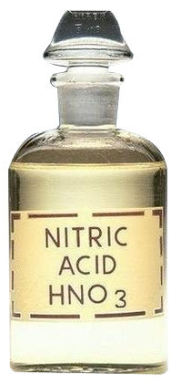
Concept Development
CFU 1
Where do the two parts of a salt come from?
Reaction of Acids with Metals
Different acids form different salts.
Hydrochloric acid forms chloride salts, eg sodium chloride.
Nitric acid forms nitrate salts, eg sodium nitrate.
Sulfuric acid forms sulfate salts, eg sodium sulfate.
Ethanoic acid (vinegar) forms ethanoate salts, eg sodium ethanoate.
CFU 2
Which acid reacts with magnesium to form magnesium nitrate?
CFU 3
What is the name of the salt formed when copper reacts with sulfuric acid?
CFU 4
What are the reactants that would form calcium ethanoate?

Slide 10
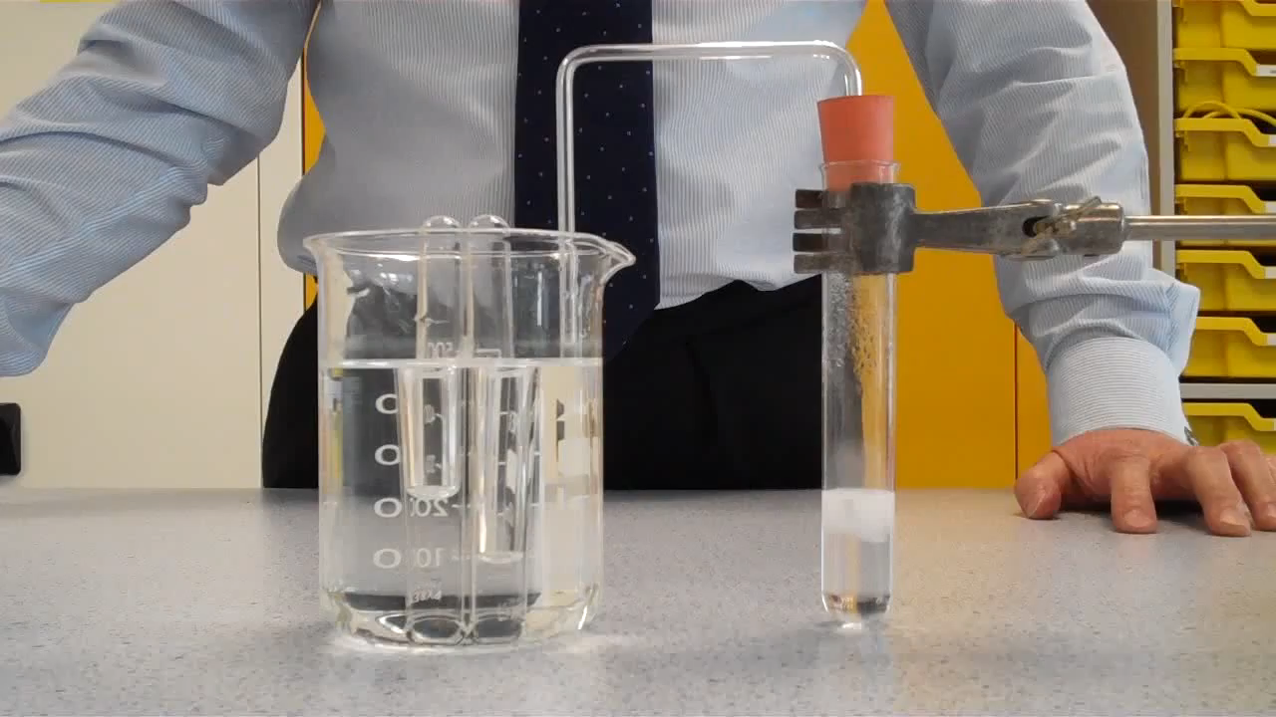
Concept Development
CFU 1
How do you test for the presence of hydrogen?
Testing for Hydrogen
The common test for hydrogen is called the ‘pop test’.
A sample of the gas is collected in a test tube.
A lit match or splint is held at the mouth of the test tube.
If hydrogen is present, a squeaky sound is heard when the hydrogen burns.
CFU 2
What will you observe if hydrogen is present?

Slide 11
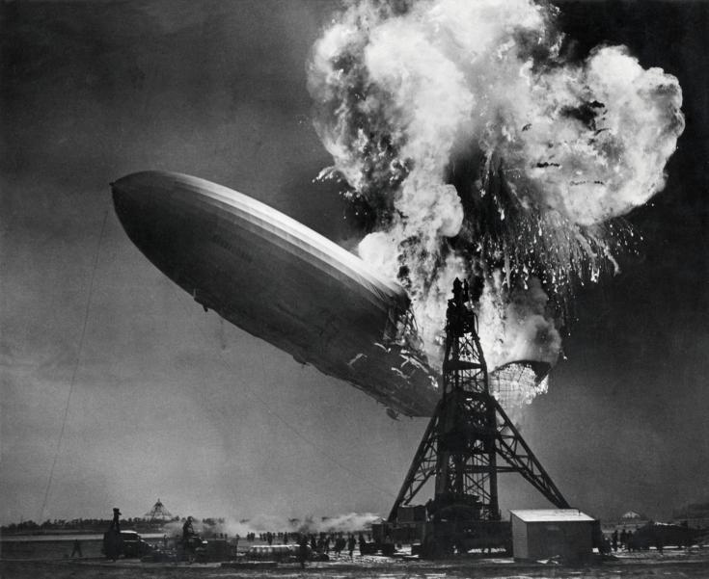
Concept Development
Trivia Time
Airships were once filled with hydrogen, as it is the lightest gas. This changed after the Hindenburg disaster. The airship caught on fire while it was landing, killing 35 people. Helium is now used instead of hydrogen because it is unreactive.

Slide 12
Skill Development / Guided Practice
CFU 1
What are the reactants?
Writing Word Equations for Acid-Metal Reactions
Identify the reactants in the reaction and write them first, with plus signs between each one.
Write an arrow at the end of the reactants, and put the hydrogen on the products side.
Identify the salt formed and add it to the products side.
Predict the products when iron reacts with hydrochloric acid.
CFU 2
What salt is formed?
Reminder
Hydrochloric acid forms chloride salts Nitric acid forms nitrate salts Sulfuric acid forms sulfate salts Ethanoic acid (vinegar) forms ethanoate salts
Reactants
Iron + Hydrochloric acid
Products
Hydrogen +
→
Iron chloride

Slide 13
Skill Development / Guided Practice
CFU 1
What are the reactants?
Writing Word Equations for Acid-Metal Reactions
Identify the reactants in the reaction and write them first, with plus signs between each one.
Write an arrow at the end of the reactants, and put the hydrogen on the products side.
Identify the salt formed and add it to the products side.
What products are formed when zinc and nitric acid react together?
CFU 2
What salt is formed?
Reminder
Hydrochloric acid forms chloride salts Nitric acid forms nitrate salts Sulfuric acid forms sulfate salts Ethanoic acid (vinegar) forms ethanoate salts
Reactants
Zinc + Nitric acid
Products
Hydrogen +
→
Zinc nitrate

Slide 14
Skill Development / Guided Practice
CFU 1
What are the reactants?
Writing Word Equations for Acid-Metal Reactions
Identify the reactants in the reaction and write them first, with plus signs between each one.
Write an arrow at the end of the reactants, and put the hydrogen on the products side.
Identify the salt formed and add it to the products side.
When sulfuric acid and copper react together, what products would be formed?
CFU 2
What salt is formed?
Reminder
Hydrochloric acid forms chloride salts Nitric acid forms nitrate salts Sulfuric acid forms sulfate salts Ethanoic acid (vinegar) forms ethanoate salts
Reactants
Copper + Sulfuric acid
Products
Hydrogen +
→
Copper sulfate

Slide 15

Relevance
Knowing how acids react with different substances will help you understand how and why acids are used for different purposes.
The reaction between metals and acids can be used to create decorative patterns on metals through a process called etching.

Slide 16
Skill Closure
Which of the compounds below are salts and which are not? Give a reason for your choice.
Magnesium chloride (MgCl₂) Methane (CH₄) Copper carbonate (CuCO₃)
Skill Closure
Explain how to test for the presence of hydrogen.
Skill Closure
Predict the products of the reaction between hydrochloric acid and zinc metal, and write a word equation.

Slide 17
Independent Practice
Collect an experiment sheet from your teacher or download it from Connect.
Complete the experiment following your teacher’s instructions.

